Slide 1

GOOGLE PLAYSTORE DATASET
GROUP - F
DATS 6103 , Fall 2019
Kartik Mathur, Trinh Vu, Sarah Gates & Ayush Singh

Slide 2







Agenda
Introduction To the Dataset
Objective
Preprocessing
Exploratory Data Analysis
Challenges Faced & New Solutions
Models & Evaluation Techniques
Results & Conclusion

Slide 3
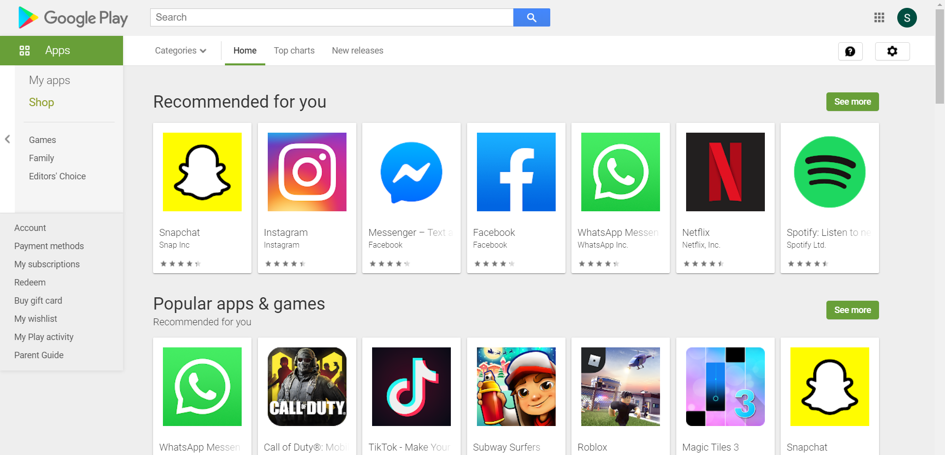
Introduction
There are approximately 2.5 million Google Play Store Apps currently available.

Slide 4
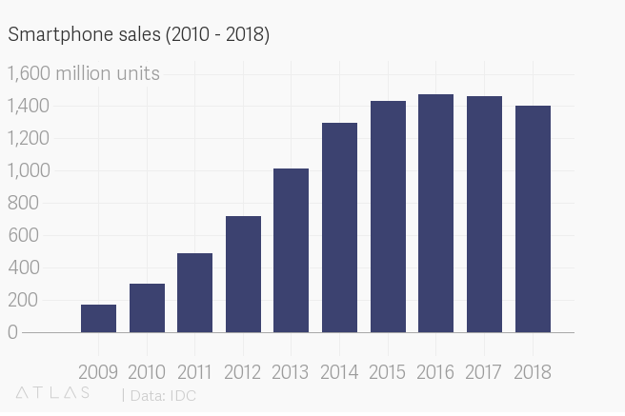
Introduction
Over 3 billion smartphone users around the world - more than 40% of the population!
More than 10 billion sold since 2007
Android Phones enjoy about 85% market share globally.

Slide 5
Features
Data Source: Kaggle
Dataset has 10,841 Data Points with 13 Variables.
App: 9660 Unique Values
Category: 18% Family, 11% Games...
Rating: 0 to 5 scale range
Reviews: Every App has a count
Size: In MBs
Installs: 10k -10M
Type: Paid & Free
Price: Free (93%) to Paid (7%)
Content Rating: Everyone, Teens....
Genres: 130 Unique Values
Last Updated : Date
Current Version of App: Varies
Android Version of Phone: Varies

Slide 6
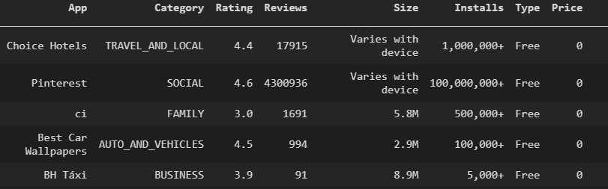
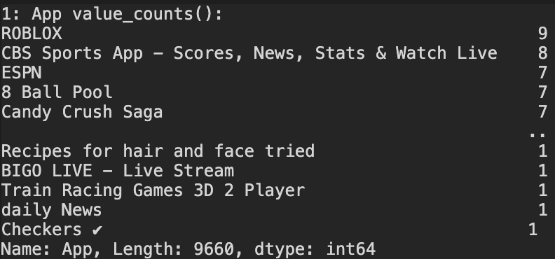
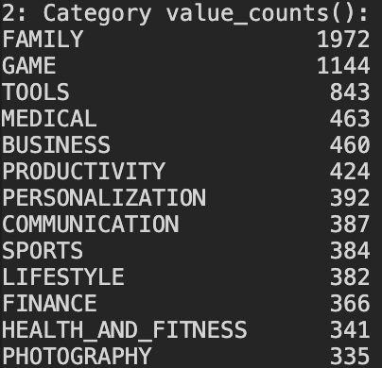
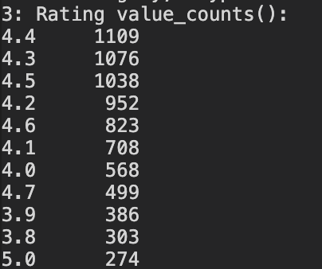
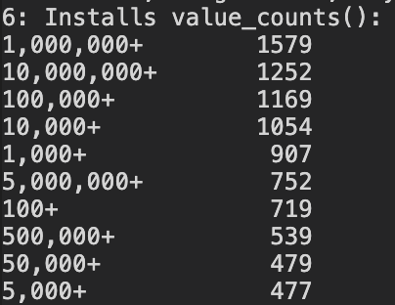
Sample of Values

Slide 7
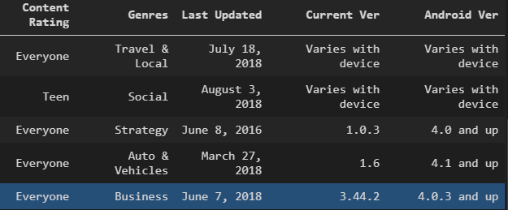
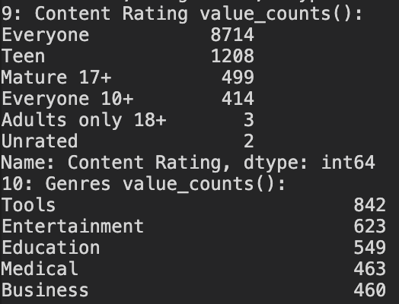
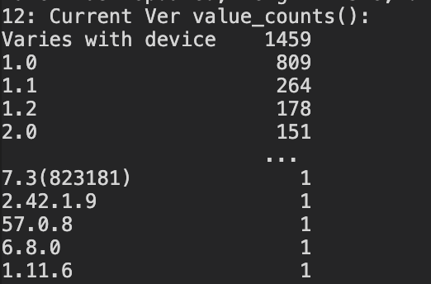
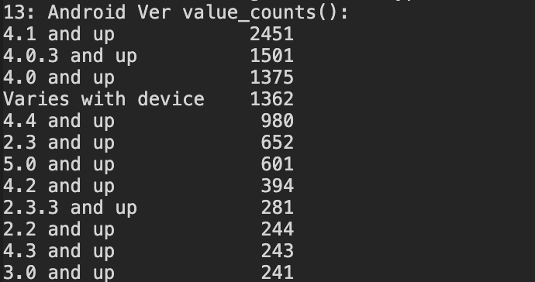
Sample of Values

Slide 8
Objective
To build data models for predicting ratings of the google store applications.
Compare models and their accuracies for the features we chose.
Applications:
Developer:
What kind of app to build ?
Models allow developers to put different variables together and predict scores of apps.
Customer:
Higher rating can be used in advertisement for business users.
Recommend free instead of paid ones providing same function and same service for individual users .

Slide 9
Pre - Processing

Slide 10
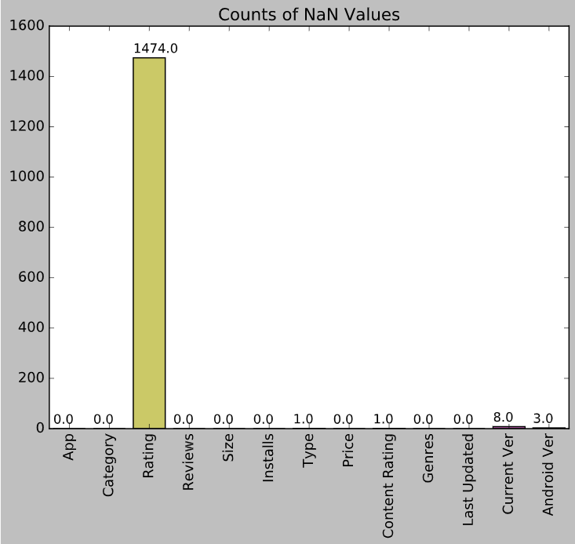
Clean Null Values
Started with 10,840 rows
App Rating, Type, Content Rating, Current Version, and Android Version had Null values
removed these rows

Slide 11
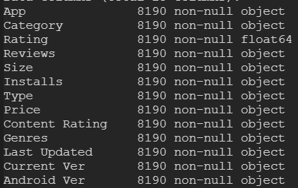
Convert Types & Remove Special Characters
Converted the following variables initially…
Reviews to int
Size to float (removed characters)
Installs to float (removed commas and +)
Price to float (removed $)
Additional cleaning steps for other models

Slide 12
Exploratory Data
Analysis

Slide 13
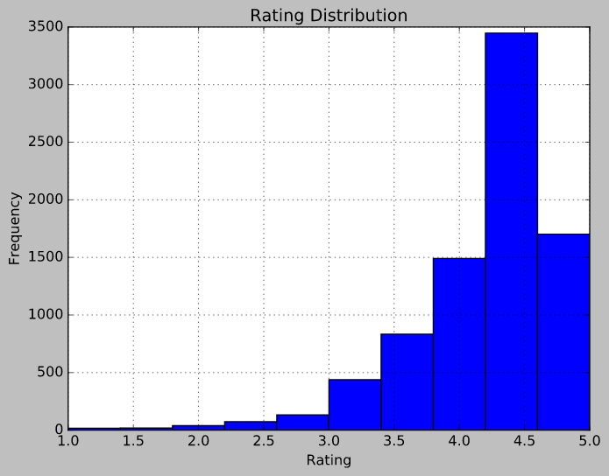
Rating Frequency
A main focus of our analysis and modeling will be on app rating
Most ratings are between 4.0 and 5.0

Slide 14
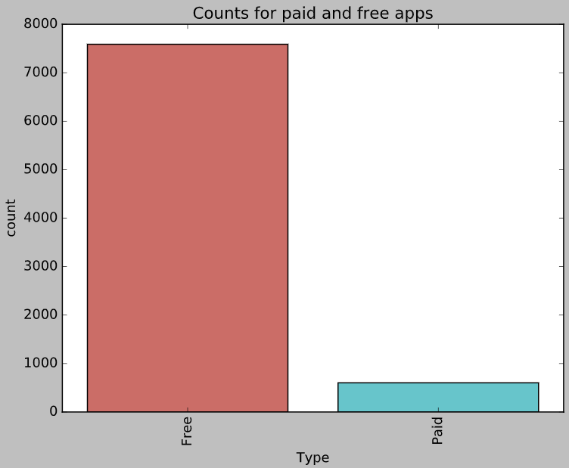
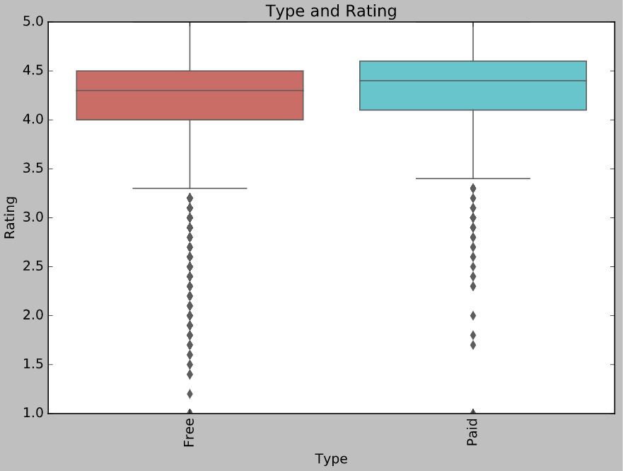
Paid Apps V/S Free Apps
Comparing the number of paid and free apps in the dataset
There are significantly more free apps than paid apps
Paid apps have a higher mean rating
the left skew is prevalent
Notes:
Comparing the number of paid and free apps in the dataset
there are significantly more free apps than paid apps

Slide 15
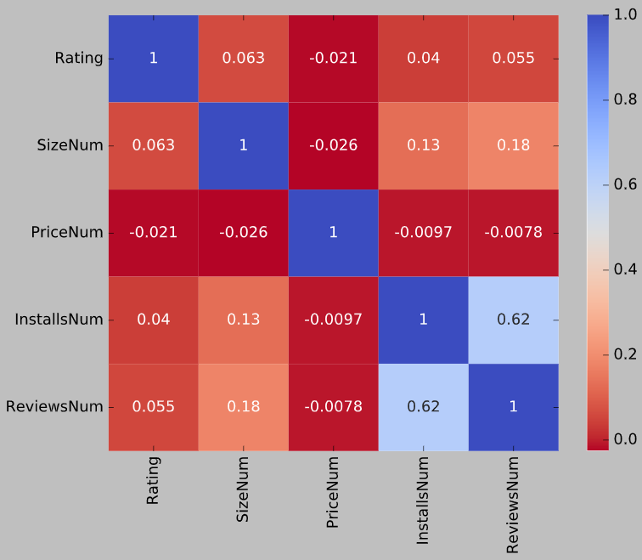
Correlations
Not many variables are strongly correlated
EXCEPT # of installs and # of reviews
This makes sense b/c the more installs an app has, the more likely it is to be reviewed

Slide 16
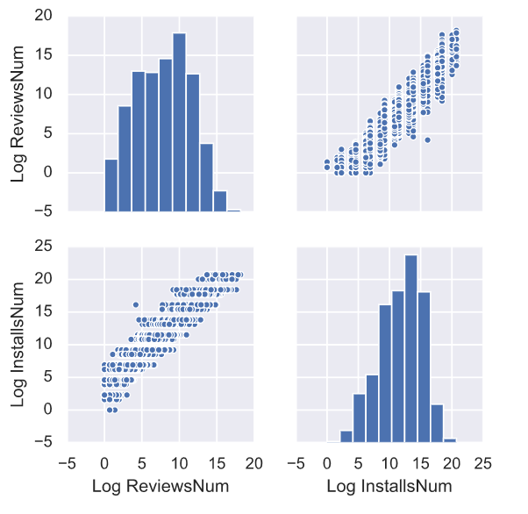
Focus on in Installs & Reviews
Log of reviews and installs shows higher correlation than raw numbers
raw numbers have exponential shape and high numbers
easier to compare

Slide 17
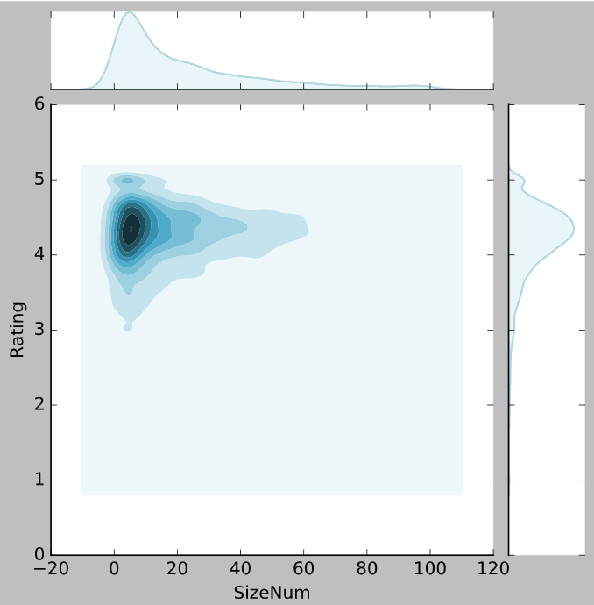
App Size V/S Rating
Smaller apps have ratings concentrated around 4.0 and 4.5
Size of apps has a slightly normal distribution with a right skew and ranges from 0M - 60M

Slide 18
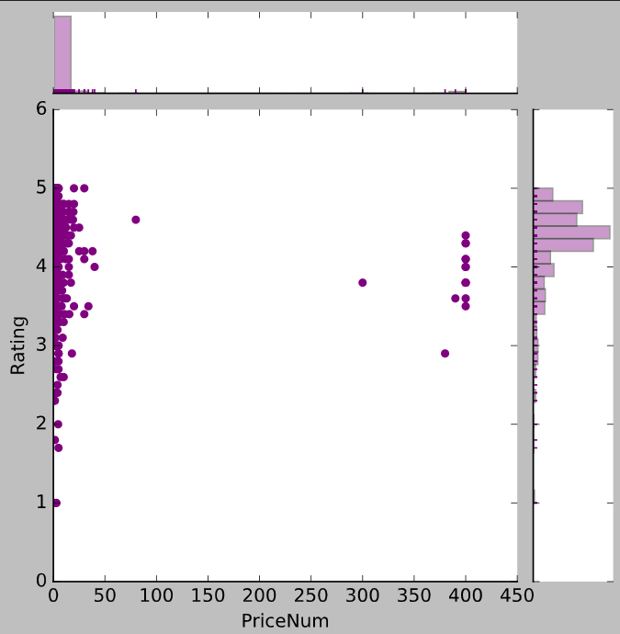
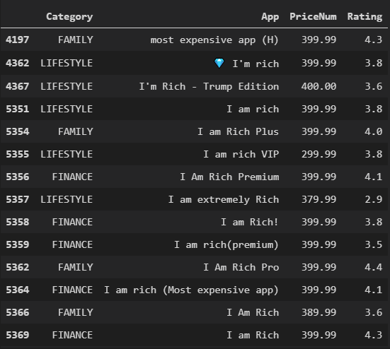
App Price V/S Rating
What are the outliers in price v/s rating?
All are a variation on “I am rich”
Categories are Family, Lifestyle, and Finance
Most are $399.99 except the Trump edition, which is $400

Slide 19
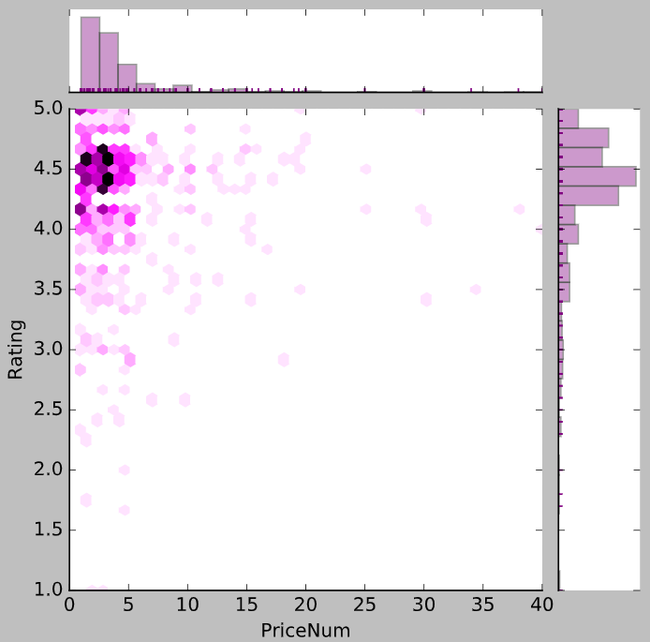
App Price V/S Rating
Removed outliers & applied hex chart to see density
Most highly rated apps are in the lower price range
BUT most apps overall are in the lower price range
No clear correlation here

Slide 20
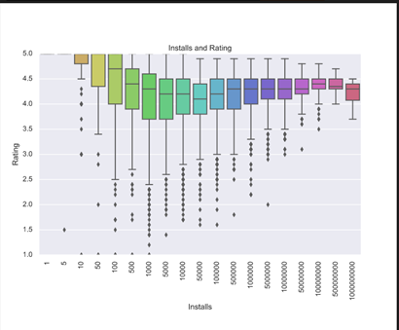
Rating vs Installs
Median rating is from 4.0 to 4.3.
Main interpretations:
The higher the number of downloads, the lower the skew of average rating
Apps with the highest installs have no average ratings below 3.5

Slide 21
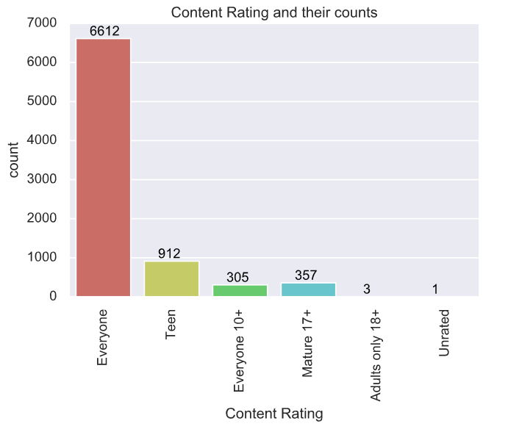
Count of Content Rating
Suitable user age
Mostly for Everyone
One unrated?
DC Universe Online Map

Slide 22
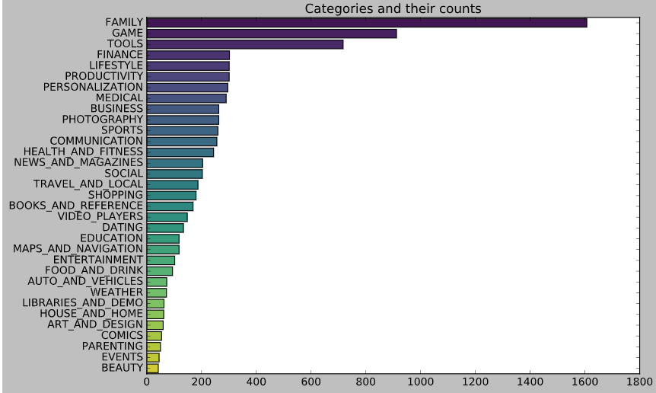
All Categories
Count of number of apps in each category
Top three categories with the most apps available are family, games, and tools

Slide 23
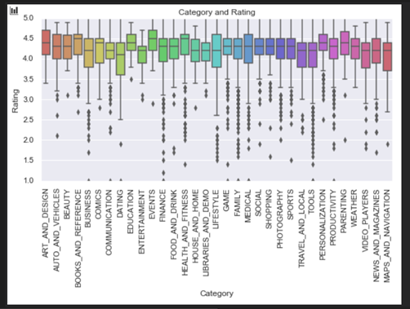
Rating by Category
Most categories have rating ranging from 3.5 to 4.8

Slide 24
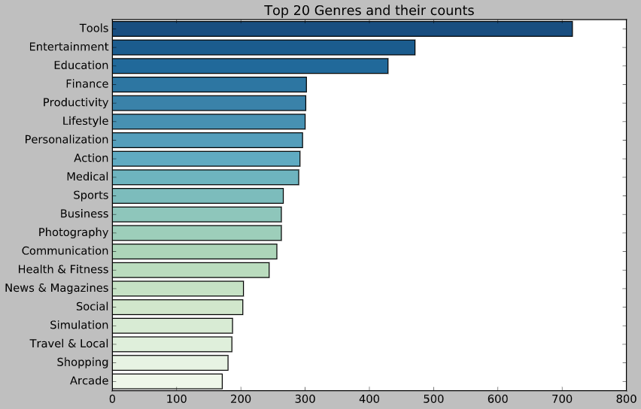
Top Genres
There are 129 genres total
This chart includes only the top 20 to get a sense of the most dominant
Top three genres with the most apps available are tools, entertainment, and education

Slide 25
MODELS

Slide 26
MODELS
MEH !
LINEAR REGRESSION
NEURAL NETWORKS
K-MEANS CLASSIFIER
REGRESSION TREE
THEY’RE OKAY !
(Categorical Labels)
SVM
RANDOM FOREST CLASSIFIER
DECISION TREE CLASSIFIER
LOGISTIC Regression
WORKS !
KNN REGRESSOR
RANDOM FOREST REGRESSOR
GRADIENT BOOST REGRESSOR

Slide 27
Challenges Faced and New Concepts
Linear Regression :
Low Correlation , R-2 = 0.003
Ratings V/S Reviews,Installs,Size,Price
K-Means
No distinct Clusters
Overlapping ( Categorical )
No real classification ( Numerical )
Categorical Variables
Label Encoding

Slide 28
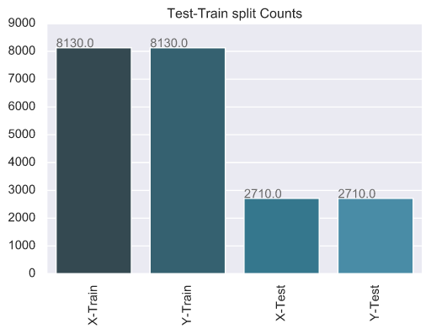
TEST – TRAIN SPLIT

Slide 29
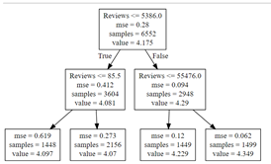
DECISION TREE
(REGRESSION TREE)
CV RMSE:
0.5181011375649769
Training set RMSE:
0.5170602730935395
Test set RMSE:
0.5545265209260778

Slide 30
COMPARE REGRESSION TREE WITH LINEAR REGRESSION
Linear Regression test set RMSE: 0.56
Regression Tree test set RMSE: 0.55
Linear Regression
score: 0.00356390811880658
intercept: [4.17220405]
coef_: [[ 1.18515233e-08 5.62132378e-11 -6.88447442e-04]]

Slide 31
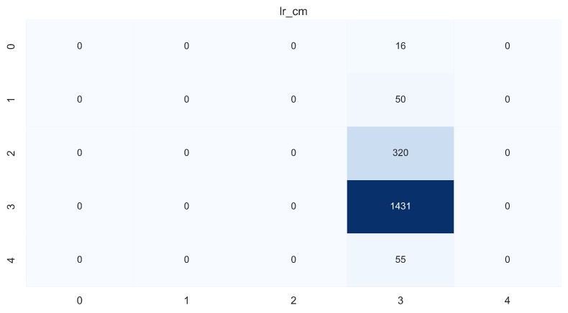
LOGISTIC REGRESSION (GROUP BY RATING)
ACCURACY
76.44230769230769 %

Slide 32
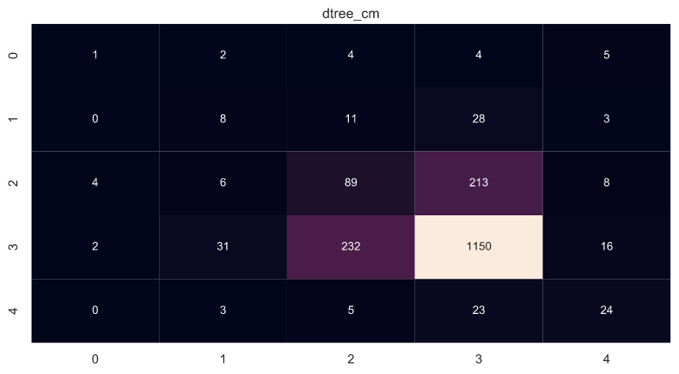
DECISION TREE (CLASSIFICATION TREE)
DecisionTree_Classifier
Accuracy:
67.94871794871795 %

Slide 33
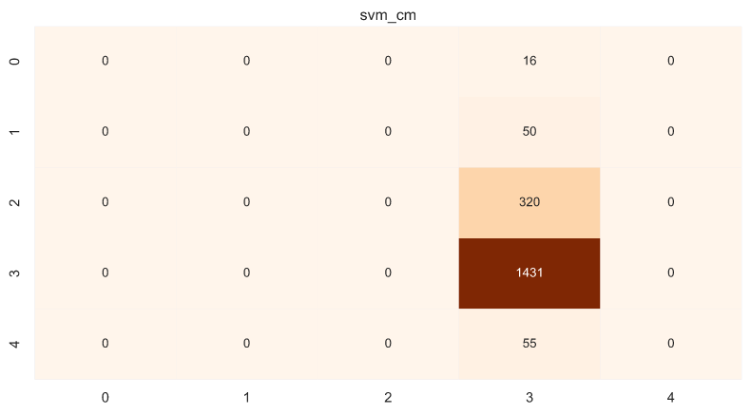
SUPPORT VECTOR CLASSIFIER
Support Vector_Classifier
Accuracy:
76.44230769230769 %

Slide 34
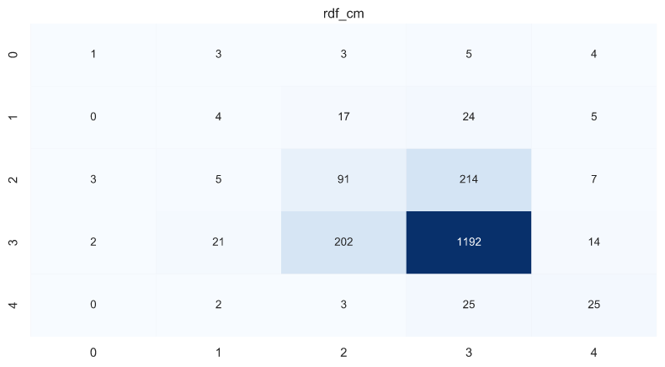
RANDOM FOREST CLASSIFIER
Random_Forest_Classifier
Accuracy:
70.13888888888888 %

Slide 35
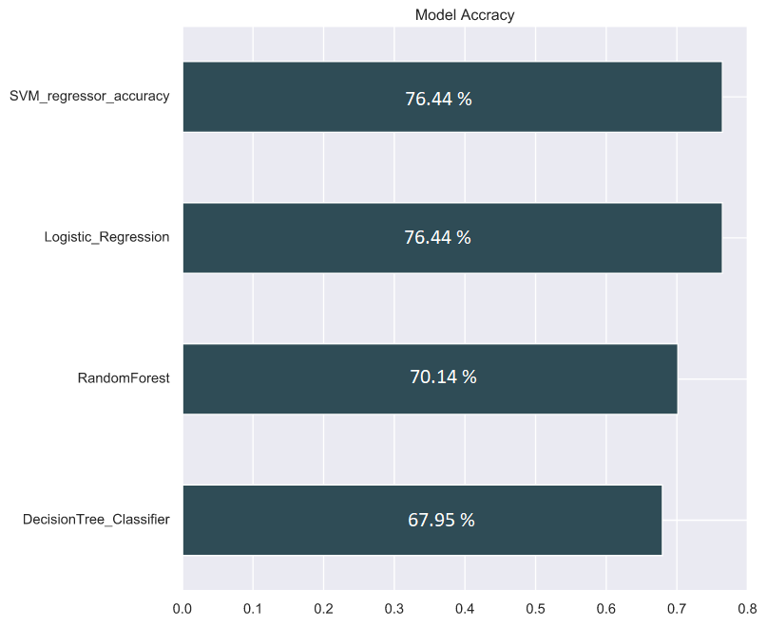

COMPARISON
These only worked because of modelling Rating as categorical labels (factor level variables)
Accuracy is lower
Not optimal

Slide 36
KNN REGRESSOR
KNeighborsRegressor(n_neighbors)
KNeighborsRegressor(algorithm='auto', leaf_size=30, metric='minkowski', metric_params=None, n_jobs=None, n_neighbors=15, p=2, weights='uniform’)
1-50 neighbors
Score = 92.223%

Slide 37
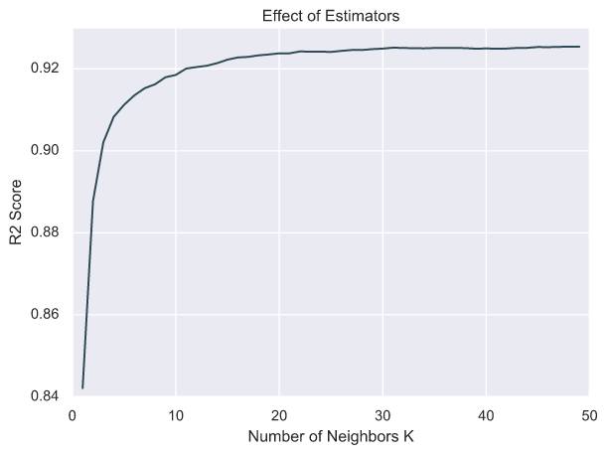
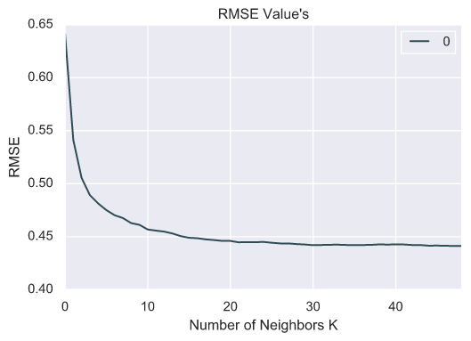
KNN REGRESSOR

Slide 38
RANDOM FOREST REGRESSOR
Decision Tree
Bagging
Multiple Weak Models to build a stronger Model
model = RandomForestRegressor(n_jobs=-1)
Estimators :- 10-200 ( Step = 10)
R-2 Score= 0.932 to0. 938
RMSE = 0.402

Slide 39
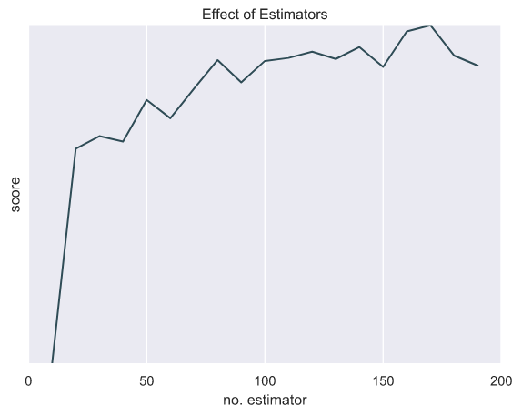
RANDOM FOREST REGRESSOR

Slide 40
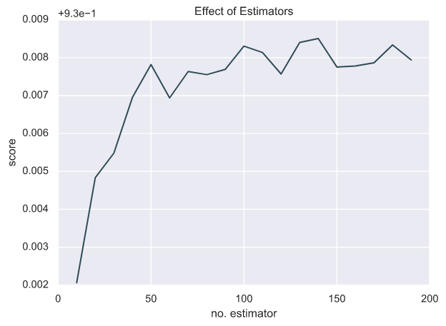
RANDOM FOREST REGRESSOR

Slide 41
GRADIENT BOOST REGRESSOR
Gradient boosting performs the identifies the shortcomings by using gradients in the loss function
( y = ax + b + e )
‘e’ needs a special mention as it is the error term)
ensemble.GradientBoostingRegressor()
Estimators:- 10-600 , Step =50
Score = 0.819 to 0.936

Slide 42
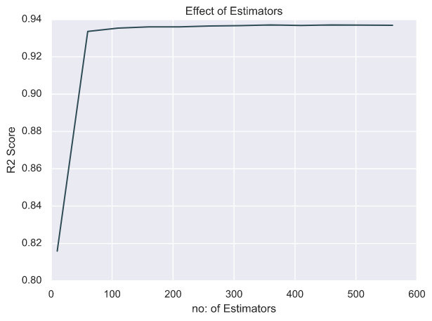
GRADIENT DESCENT REGRESSION

Slide 43
Conclusions &
Future Prospects

Slide 45
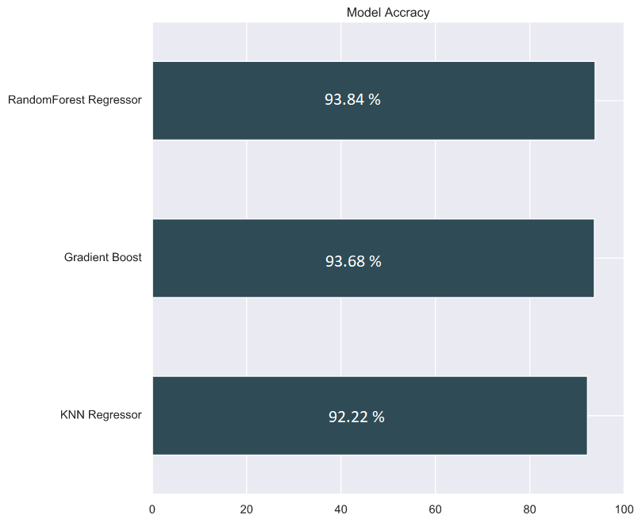

Slide 46
Future Prospects
Natural Language processing on User Reviews
Predicting app prices & Installations
Most profitable apps to advertise in
Predict advertising revenue (in B to B relationship)
Determining most Popular Applications

Slide 47
THANK YOU
Questions ?

